Slide 1
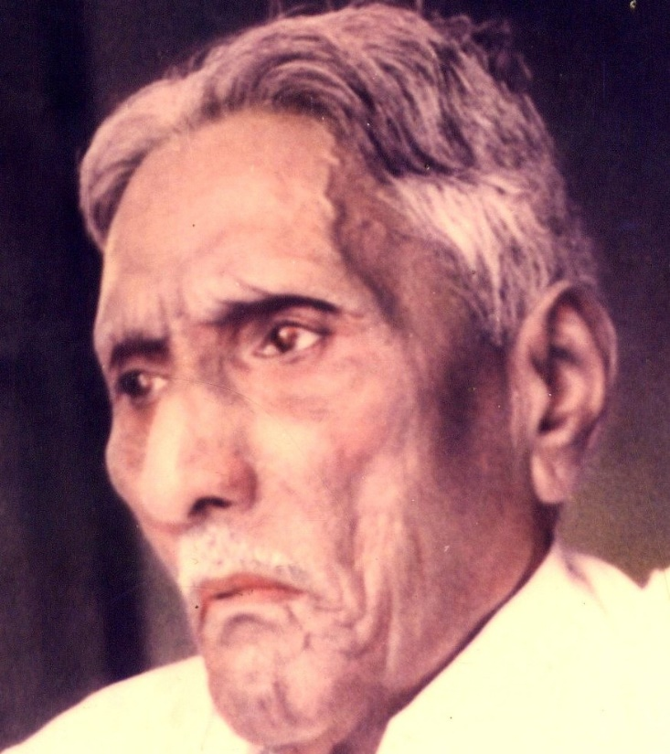

The Bible Mission The Revelation of God to St. M. Devadas The Bible Mission’s Annual Conference

Slide 2
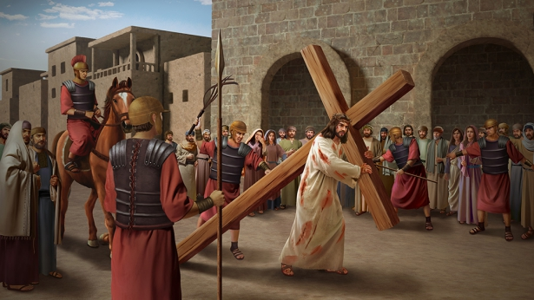
Persecution is of two types:
2. Persecution : Perfection of the Bride
a) External Persecution
b) Internal affliction

Slide 3
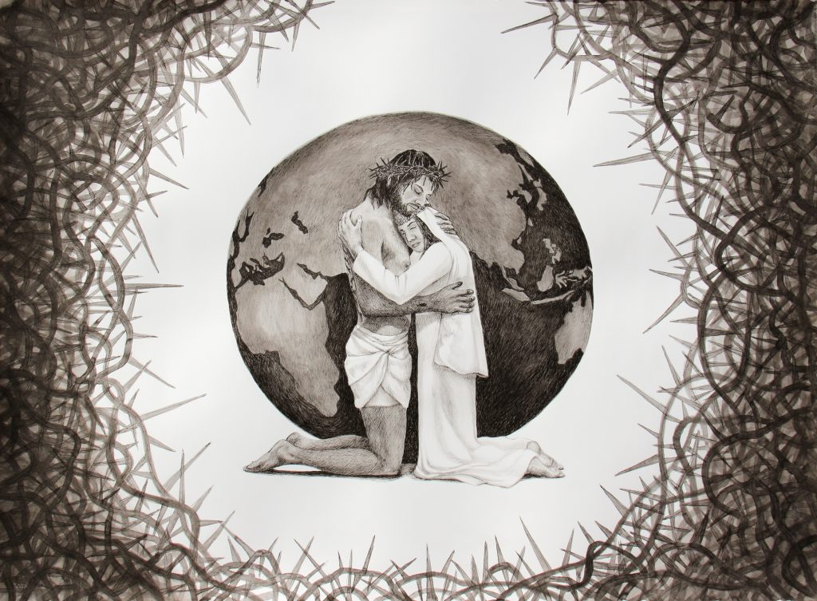
In the song of solomon, we are referring to internal affliction or suffering of the bride.

Slide 4
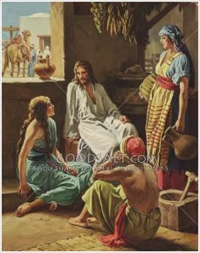
“Like a lily among thorns is my love among the maidens” song of solomon(2:2)

Slide 5
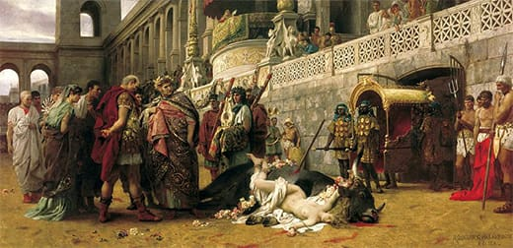
The Spirit of Righteous Intolerance:
Get rid of all bitterness and anger.

Slide 6
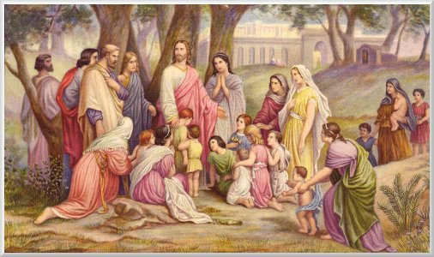
The Spirit of indignation and looking down:
Don’t let the sun go down on your anger

Slide 7
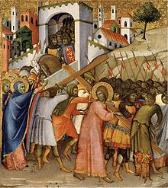
For Christ’s sake, delight in weakness, in insults, in hardships, in persecutions.

Slide 8
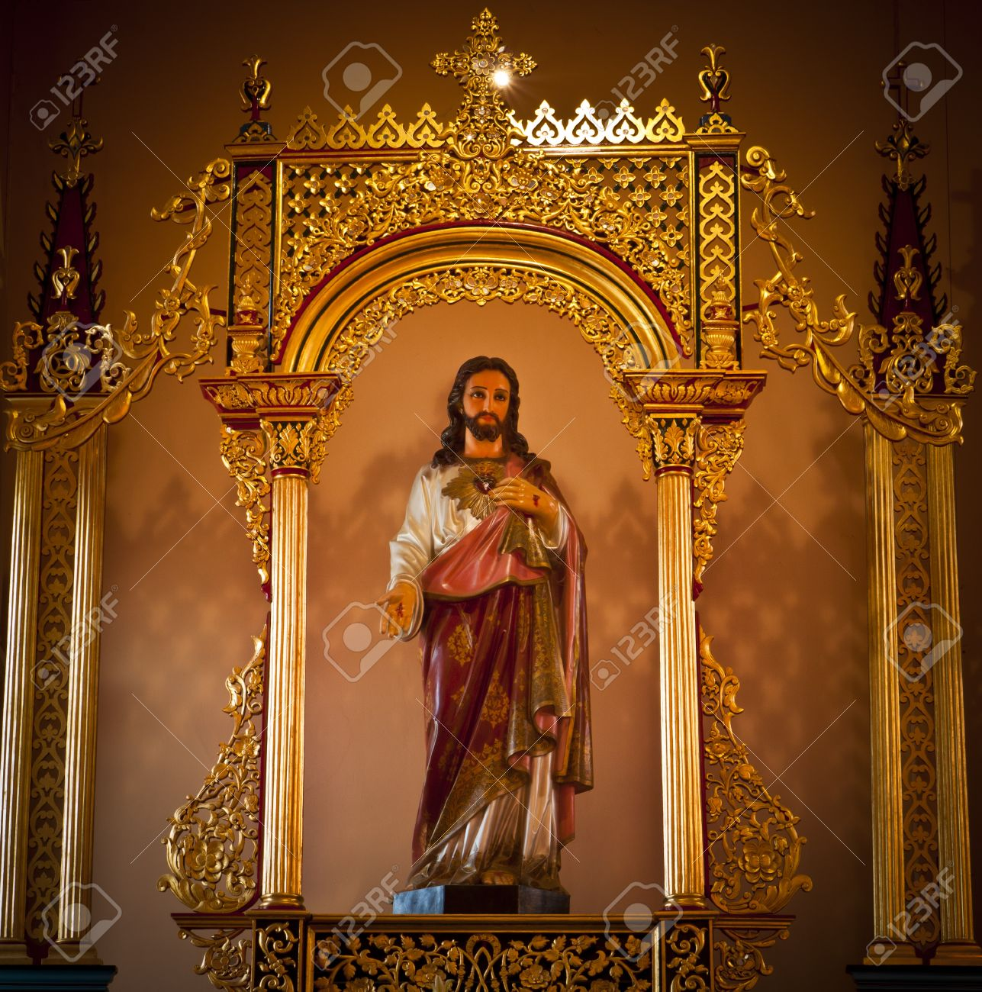
The Church which loves the world is with worldly pride and pomp.

Slide 9
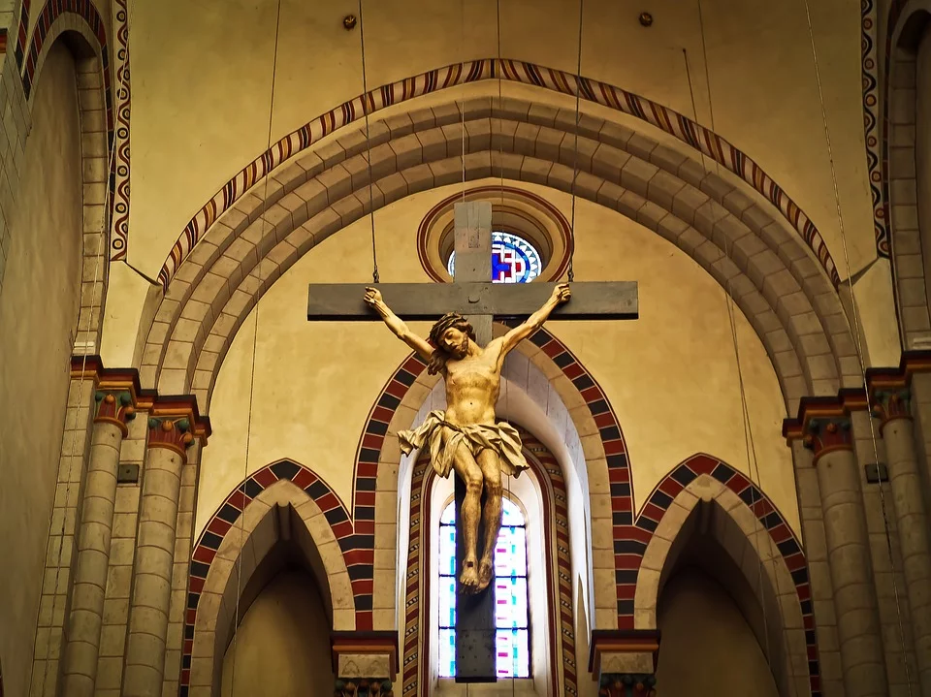
The church which is far from the world is being looked down by worldly churches and persecuted by the world.

Slide 10
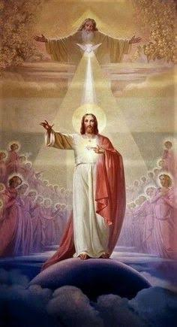
May the Holy Spirit Father Bless and Establish all of us to be His Bride.
AMEN

